Slide 1





Program
May
Planning
2020
1

Slide 2

Introductions
&
Agenda
Presenters
Roundtable Chair
District Executive
Agenda
✓
✓
✓
✓
✓
✓
Why Program Planning
Planning the Ideal Scouting Year Materials
Needed & Available Resources Annual
Program Planning – Steps to Success
Funding the Annual Program
Growing Your Unit (Youth & Adults)
2

Slide 3
Why
Program Planning
•
•
•
•
•
•
More Fun
Better activities
Better Participation
New members want to join
Retention
Maintain your sanity
Fail
to
Plan...
…Plan
to Fail
3

Slide 4

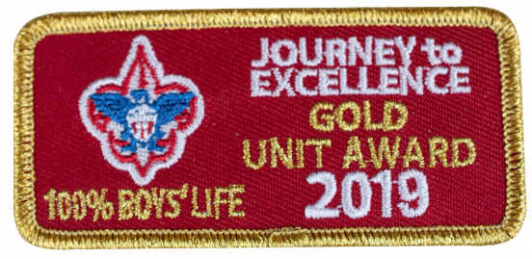
Journey to Excellence
What is JTE?
•
•
Award for all units
Recognition of strong program
Outline for success
A great program planning
tool!
•
•
4

Slide 5
Journey to Excellence
Four
Focus Areas
1.
Planning and Budget
•
Conduct annual planning meeting
2.
Membership
•
Recruiting, Retention & Webelos to
Scout Transition
3.
Program
•
Advancement, Activities,
Service
&
Summer Camp
4.
Volunteer Leadership
•
Recruiting & Training
5

Slide 6
Getting Ready to Plan
Materials needed:
•
Council Program Planning Guide for 2020-2021
o
Includes council & district dates
•
•
•
•
Journey to Excellence Scorecard
Applicable school district & church calendars
Parent Information Surveys
Leader guides & handbooks
6

Slide 7
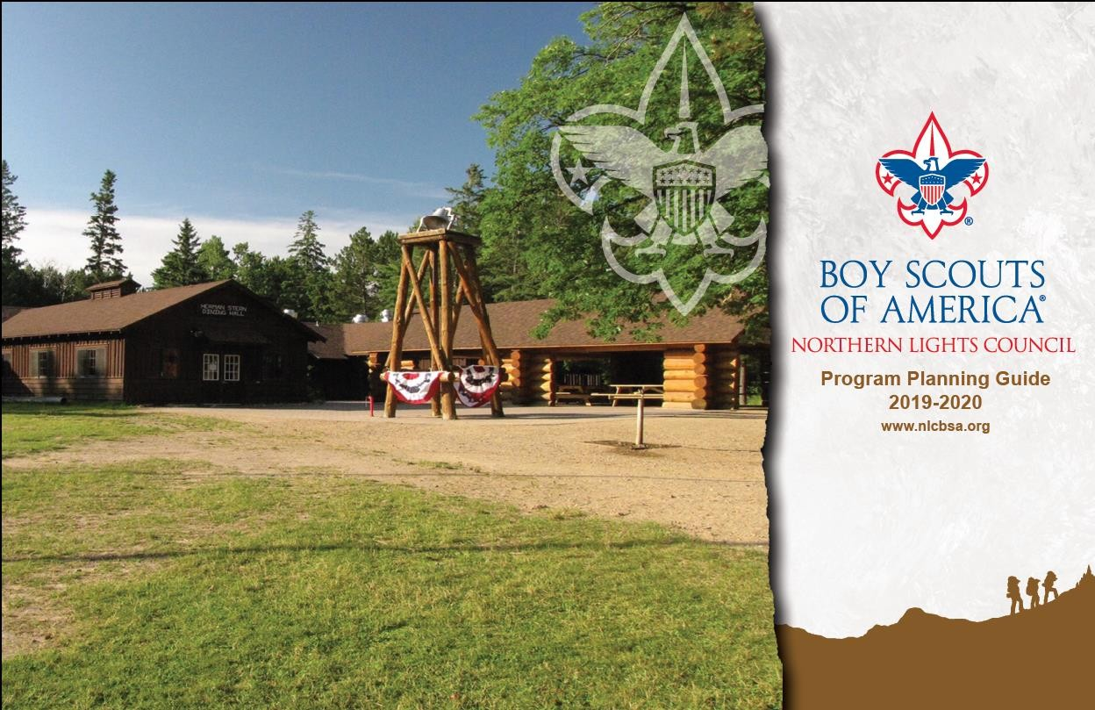
Council Program Planning
Guide
•
Includes council & district dates
•
Other resources for planning
Also available at
https://stlbsa.org/programs/recruitment/
7

Slide 8
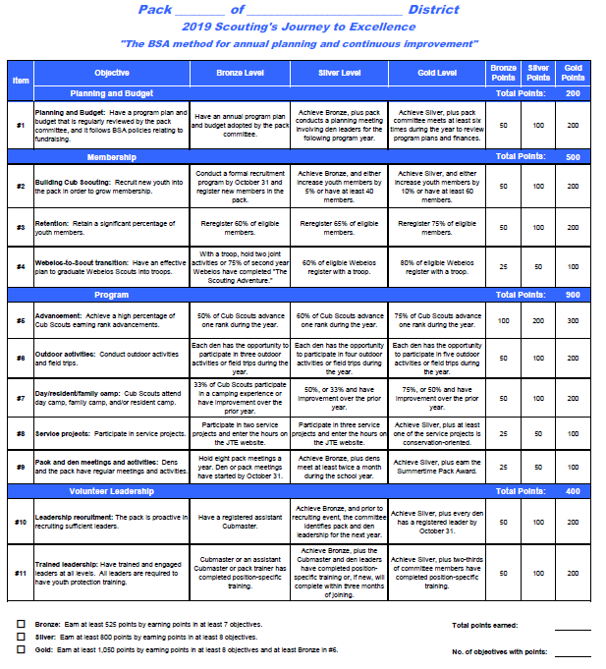
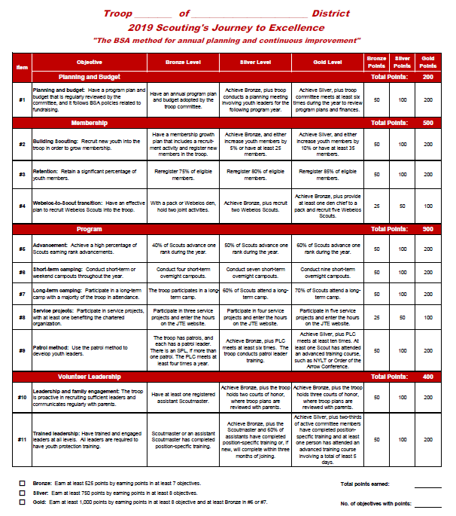
Journey
to
Excellence
Scorecards
JTE Scorecard for Packs
JTE Scorecard for Troops
8

Slide 9

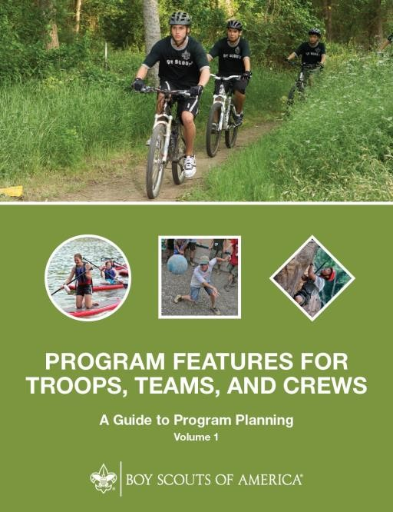

Leader
Guides
&
Handbooks
Troop Program Features I, II, III
Troop Leader Handbook. Volume I
starts page 144
9

Slide 10

Other Resources
There
•
is Always
Help Available
Council & national websites
www.stlbsa.org/
www.scouting.org
Pack & Troop Websites
Council sponsored fundraisers
Ideal Year of Scouting – Unit Budget Sheet
Chartering Organization
Unit Commissioner
Council staff
•
•
•
•
•
•
10

Slide 11
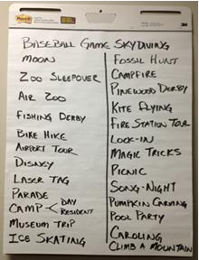
Steps to Success
Step
#1 – Conduct a Program Planning meeting
Gather input from Scouts & parents – what activities would
o
they be most interested in, or in other words –
be their “Ideal Year of Scouting”?
what would
o
Write down all of
their ideas on a
flip chart
11

Slide 12
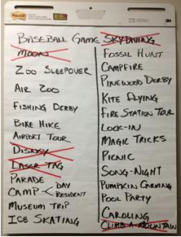
Steps to Success
Step #2 – Unit
feasible
Committee
determines which ideas are
✓
Cross off activities that are
against BSA policy
✓
Cross off activities that are not
feasible (going to the moon
would be great, but…)
✓
Don’t be to eager to cross of
things that might be possible with
more planning (Disney Land)
12

Slide 13
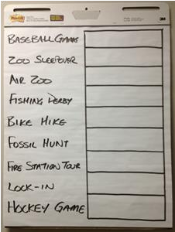
Steps to Success
Step
#3
–
Create
a
“voting” chart
✓
Consider adding council activities
that the Scouts and Parents
might not have
thought about
13

Slide 14
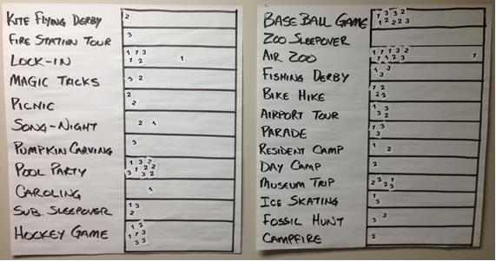
Steps to Success
Step
#4
–
Everyone
Votes
✓
Give each Scout/Parent
some stickers
✓
Ask the Scout/Parent to
put their stickers on their
1st, 2nd
and
3rd
choice of
activities to participate in
next year
14

Slide 15
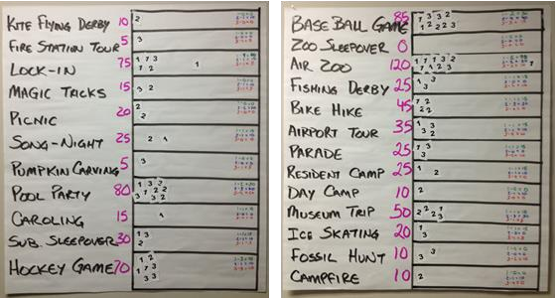
Steps to Success
Step
#5
–
Tally up
the
Results
✓
15 points for
1st
choice
✓
10 points for 2nd choice
✓
5 points for
3rd
choice
15

Slide 16
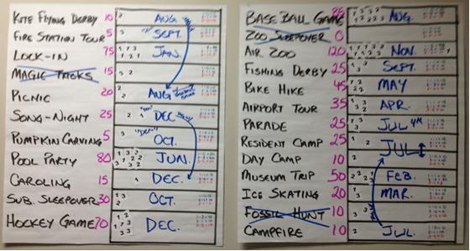
Steps to Success
Step
#6
–
Assign
months
for
the
highest
rated
activities
16

Slide 17
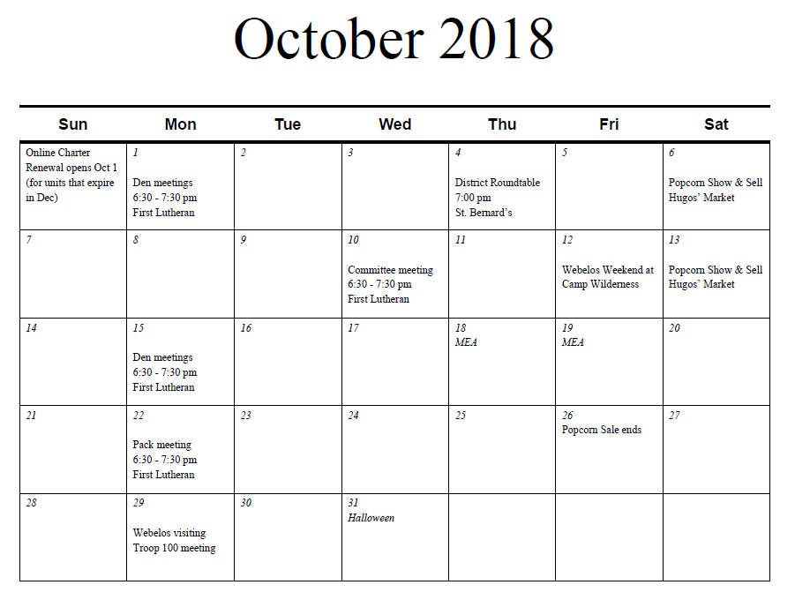
Steps
to
Success
Step #7 – Create a calendar for your
unit
17

Slide 18
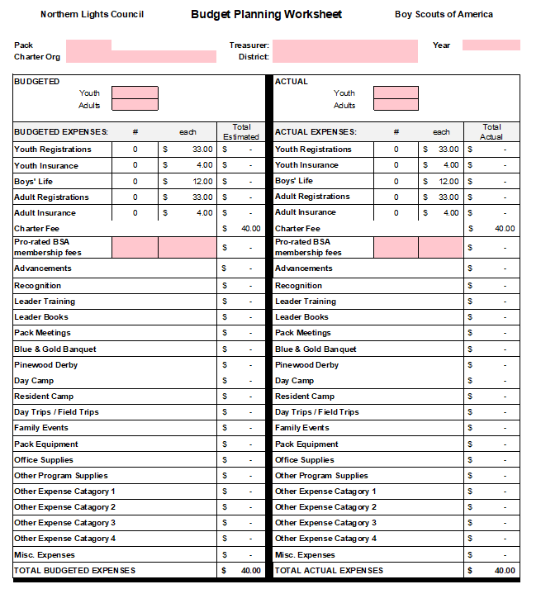
Steps
to
Success
Step #8 – Build the “Ideal Year of
Scouting” budget
✓
Work on the budget after completing
calendar
✓
Determine how much money needs to be
generated during the fund raising period
✓
What is goal for each Scout?
18

Slide 19
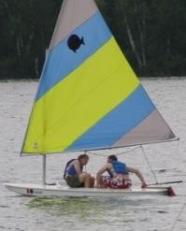
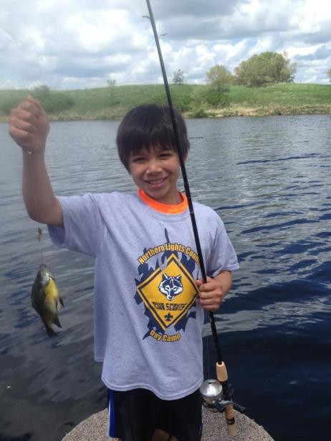
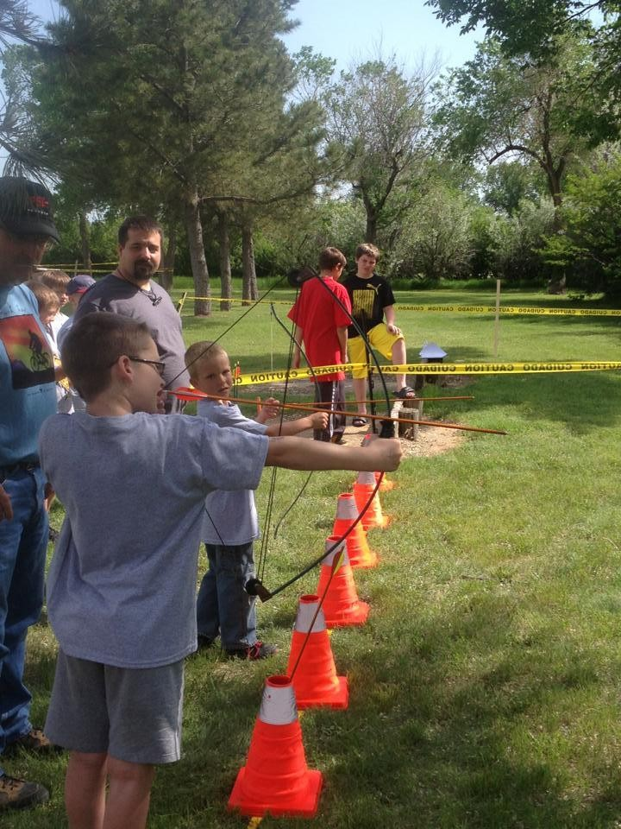
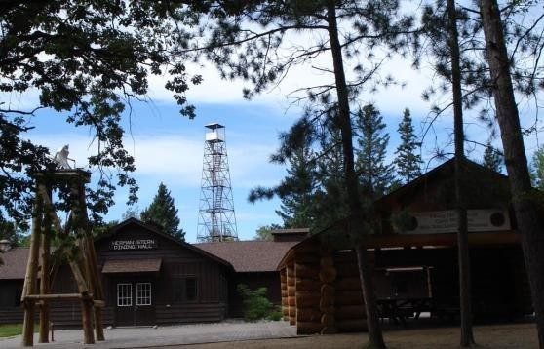
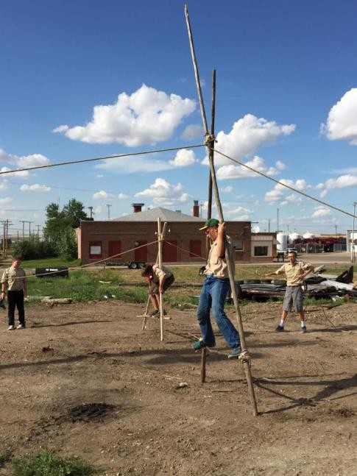
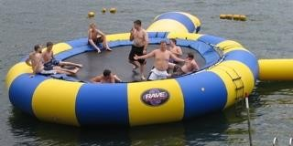
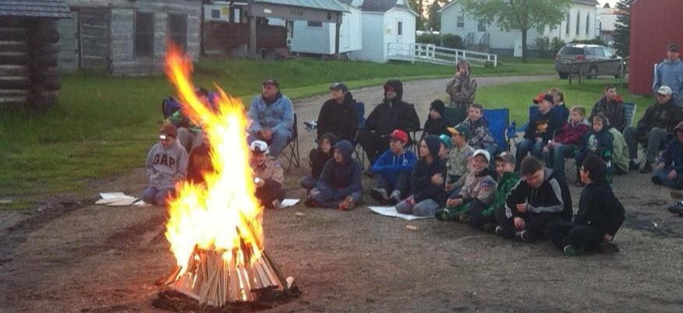
What
is
the
Money For?
Program!
19

Slide 20
Steps to Success
Final
Step – Share your calendar and budget!
You will be ready to share the unit program calendar and budget with all of the families, update regularly to have available for any new families all year long.
o
o
This will demonstrate to new families that your unit is
organized and does really great activities!
o
Provides motivation for parents/Scouts to participate in
your fund raising activities (so it won’t break their personal
checkbook)
20

Slide 21

Growing Your Unit
Cub Scouts
Family Scouting (where
Spring & Fall Recruiting
available)
Scouts BSA
•
Linked Troop available for
Feb/Mar of 2019
Spring & Fall Recruiting
full family starting
•
•
Webelos to Scout Transition
21

Slide 22
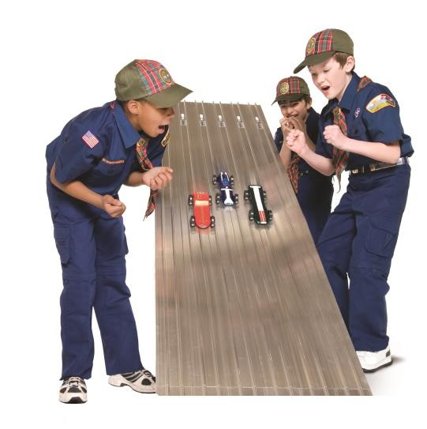
Growing your Unit
Recruiting Volunteers
•
Utilize the “Parent Information”
form
Personally ask parents to help with a specific job that they know how to do (within their “comfort zone”)
Develop a Succession Plan for Key leaders
•
•
22

Slide 23
Questions?
Thank you for your attention
23

